Slide 1
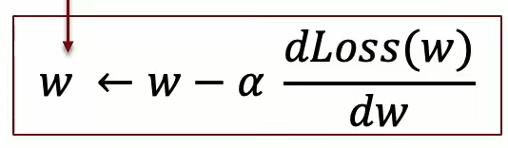
Deep Learning for Computer Vision – Building Convolutional Neural Networks from Scratch
What is an epoch
  One pass through a training set
    Get the predicted values from the training set
    Calculate the gradient loss
    Update the weights
  For SGD – We process the data in minibatches (batches)
    For every batch the weights are recalculated and once all the data has been put into the batch the epoch is over
    For each batch we do gradient descent then calculate the loss using Gradient Descent and then update the predictions
    The epoch is the processing of all the batches
Batches – Use smaller sets (faster to calculate) , but should move into the right direction
Example
  Training Set Size = 194
  Batch Size = 32
  Then: Training Set / Batch Size = 7 with a remainder of 2
  So we have 6 batch with the seventh batch containing 2

Slide 2
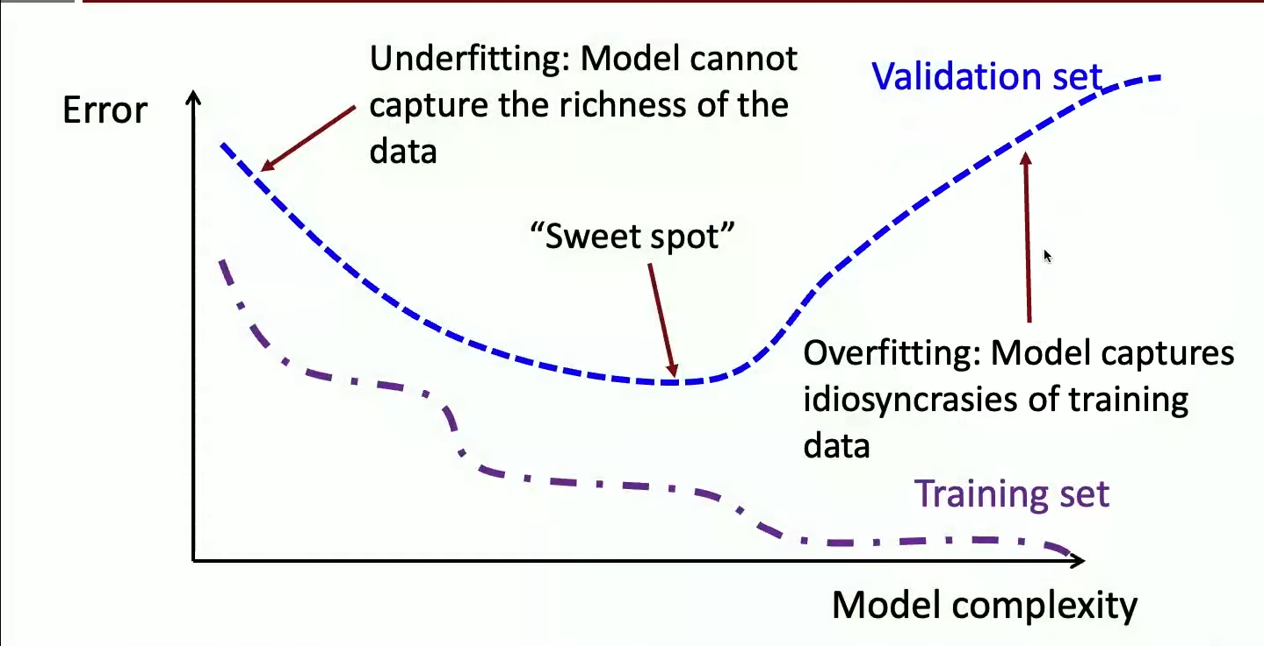
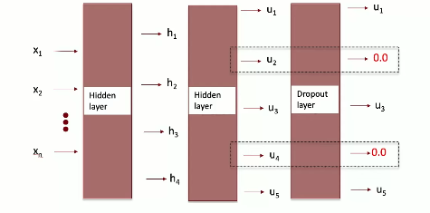
Deep Learning for Computer Vision – Building Convolutional Neural Networks from Scratch
Overfitting vs underfitting
  Overfitting see 1st picture to right
  Goal find the sweet spot
To learn representation of complex unstructured data needs to have a large
capacity ( many layers and neurons )
  more parameters means more complexlity
  raise the possibility of overfitting so regularization is needed
2 methods ( regularization ( handle risk of overfitting )
  Early Stopping – Stop the training before the training loss is minimized
  by monitoring the loss on a validation set
    When the validation set flattens out
  Drop Out – Randomly zero out the output of some of the nodes
  ( typically 50%) of the nodes in a hidden layer
    implemented as a drop layer in keras
Creating/Training a Deep Neural Network from scratch
  Get the data ready
  Design the network ( choose hidden layers and number of neurons
  in each layer
  Pick the output layer based on the output needed ( single, list, probability )
  Pick the loss based function an an optimizer ( SGD Type )
  Decide on regularization strategy
Validation Set is used to calculate accuracy and loss

Slide 3
Deep Learning for Computer Vision – Building Convolutional Neural Networks from Scratch
tensor or a generalization of a number, vector, matrix to higher dimensions
  Rank 0 – value
  Rank 1 – vector
  Rank 2 – Matrix Could be a Black and White Picture
  Rank 3 – Cube Could be a Colored Picture
  Rank 4 -- Video
A tensor of Rank 10 is just a list of Rank 9 tensors
  Ex. A list of Videos is Rank 5
    Iterate through the first dimension of it.
Tensor Flow
  Tensors flowing from input to output
  Automatic Calculation of the gradient of ( complicated loss functions )
  Library State of the Art Optimizers
  Automatic Distribution of computational load across servers ( parallelization )
  Automatic Adoption of code to work on Parallel hardware ( GPU and TPU )

Slide 4
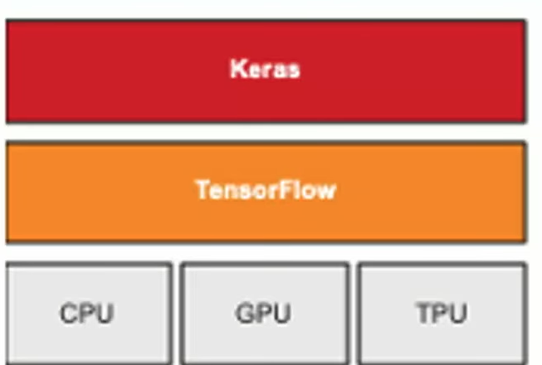
Deep Learning for Computer Vision – Building Convolutional Neural Networks from Scratch
Software Stack
  See picture on the left
  Keras provides conveyance features
    Pre-defined Layers
    Flexible ways to specify network architecture
    Easy ways to process data
    Easy ways to train models and report statistics
    Pre-trained models you can download and customize
  Three ways to build Deep Learning Models with Keras
    Sequential
    Functional Main architecture that will used in class
    SubClassing
PyTorch requires more CS Understanding such as Object Orientated Programming
Websites: tensorflow.org, keras.io

Slide 5
Deep Learning for Computer Vision – Building Convolutional Neural Networks from Scratch
Example
  Code for the model
    input = Keras.model(shape=29)
    h = keras.layers.Dense(16, activation=”relu”)(input)
    output = keras.layers.Dense(1, activation=”sigmoid”)(h)
    model = keras.model(input, output)
Training Checklist
  Get the data ready Covered in Colab
  Design the network
    Choose the number of hidden layers 1
      Number of neurons in each layer 16
    Output Layer Sigmoid
  loss Function Binary Cross Entropy
    Used when predicting a probability
  An Optimizer Adam
  Regularization Strategy Early Stopping

Slide 6
Deep Learning for Computer Vision – Building Convolutional Neural Networks from Scratch
Notes on Colabs used in class are also linked in the lecture notes
  for stochastic descent where batches are being used.
    create the batches and then randomly shuffle them then calculate the loss and update the weights.
  Source of randomness
    starting values of weights
    Split the data into Train, Validation, Test
    Batches
    Drop Out
  keras.utils.set_random_seed(42)
  Since the output is boolean get the percentage of the True/False
    The false is 72.6 and the true is 24.4
    If we 0 there is a 72.6% chance of being correct
  Preprocessing
    One Hot Encode
      pd.get_dummies
    Normalize
      Worked best when the numbers are in a small range ( small variation )
      split the data into traing/validate/test before doing normalization – so the test set is not influence by the training set
      To get the test set use df.sample
      To calculate the mean and standard deviation use <dataframe>.mean() and <dataframe>.std()

Slide 7
Defaults
Use Relu for activation functions
Use Adam for regularization

